Slide 1
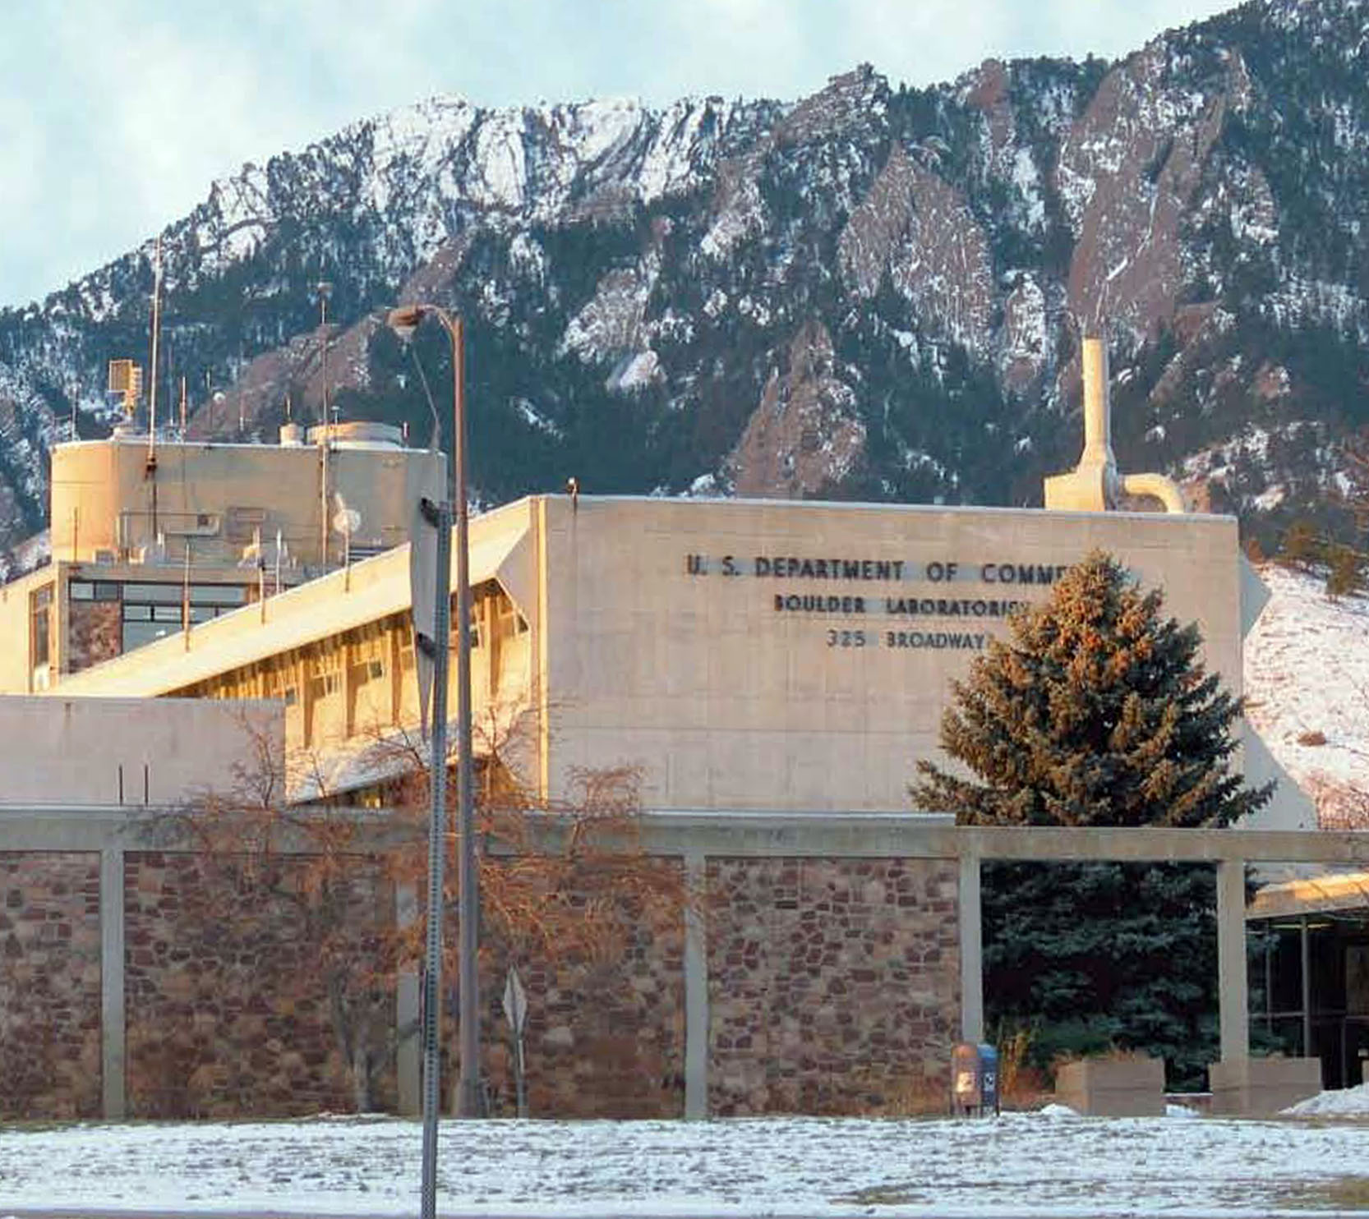

An Overview of the
Institute for Telecommunication Sciences (ITS)
Brian Lane, Executive Officer, ITS
Institute for Telecommunication Sciences – Boulder, Colorado

Slide 2
ITS Contributions to NTIA Strategic Objectives
ITS Contribution | DOC Strategic Objectives
Spectrum and propagation measurements | Promote U.S. telecom and information infrastructure development
Standards development | Improve foreign trade opportunities for U.S. telecom firms
Joint research with industry Joint research with industry Audio, Video and Multimedia Quality Research | Enhance domestic competitiveness
Spectrum sharing research | Facilitate more efficient and effective use of radio spectrum

Slide 3
ITS Funding
Total: $16.1 million
Cooperative Research and Development
Agreements (CRADA) — $100K
50% Direct Funding
50% Reimbursable
$8 million
Reimbursable Funding from Federal Agencies
$7 million
Direct Funding from Congress
(S&E)
$1 million
Office of Spectrum Management (OSM)
Institute for Telecommunication Sciences – Boulder, Colorado

Slide 4
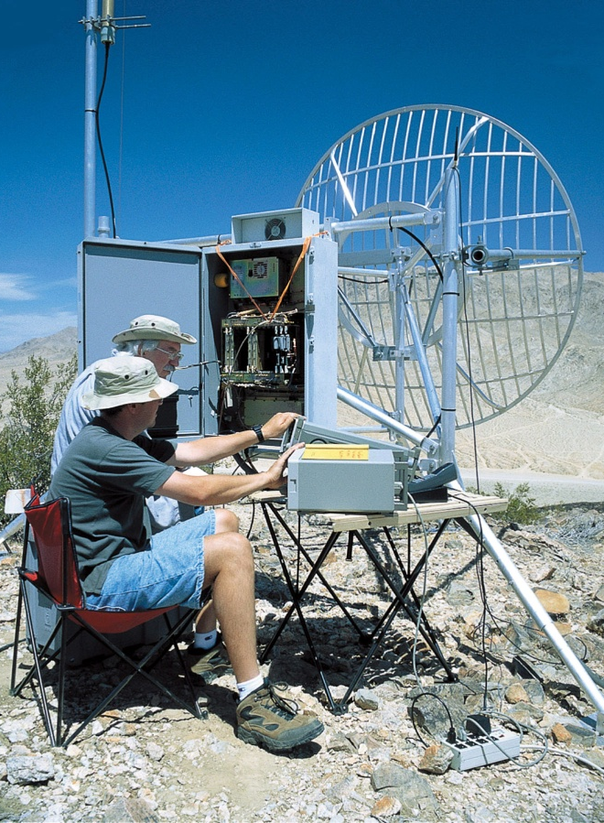
Major Research Programs
Spectrum Sharing Research
Spectrum Measurement Research
Radio Propagation Research
ITU-T and ITU-R studies
Public Safety Communications Research
Audio, Video and Multimedia Quality Research
Institute for Telecommunication Sciences – Boulder, Colorado

Slide 5
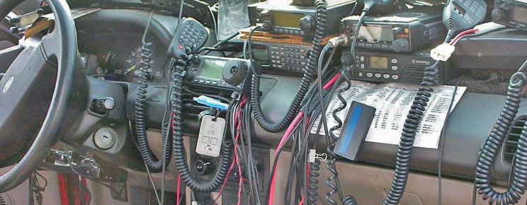

Public Safety
Joint effort between ITS and NIST Office of Law Enforcement Standards (NIST/OLES)
One of the longest-running Other Agency-funded efforts (≈14 yrs)
Supports DOJ and DHS interoperable public safety communications efforts
Areas of research
  Land Mobile Radio Standards
  Broadband Standards
  Interoperability device testing
  Emerging standards and technologies
www.pscr.gov
Notes:
Key highlights:
LMR – Project 25 standards development and Compliance Assessment
Broadband – Long Term Evolution (LTE) and Public Safety 700MHz BB Demonstration Network in Boulder
Public Safety Audio Quality and Video Quality testing with actual first responders – testing done onsite in ITS labs

Slide 6
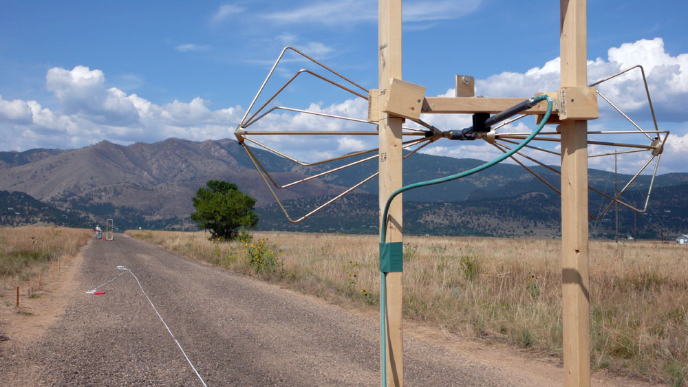
Radio Propagation Research
Development and Maintenance of Propagation Models
On-Line Propagation Models and Data via TA Services
Geographic Information System (GIS) Applications
                Recent Development of Short-Range (<1 km) Propagation Model
                Ultra-Low Antenna Height Modeling and Measurements
                Development of a Ground-Conductivity Measurement System

Slide 7
Spectrum Measurement Research
Spectrum Measurements
  Occupancy
  Individual Transmitters
  Noise
Field measurement efforts to
resolve and prevent interference
  Radars
  Communication Systems
  Radio-Jamming Systems in Prisons
Spectrum-Sharing R&D
  Dynamic Frequency Sharing (DFS) Research in Radar Bands
  Dynamic Spectrum Access (DSA) Testbed for LMR bands
  Interference Protection Criteria (IPC) for Spectrum-Sharing

Slide 8
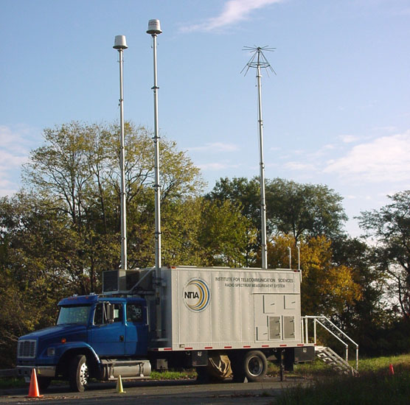
RSMS Van

Slide 9
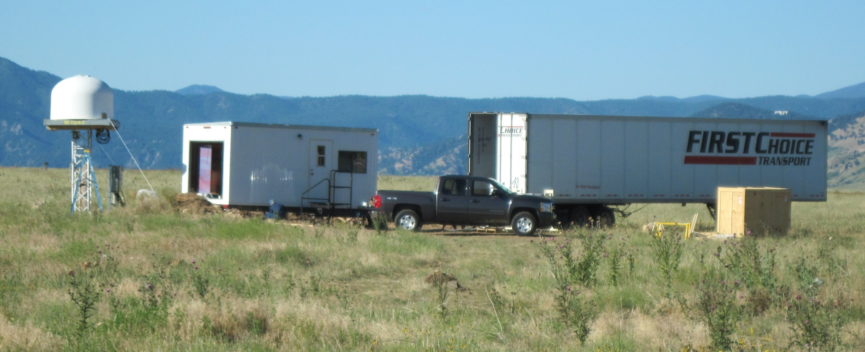
Table Mountain “Quiet Zone”

Slide 10
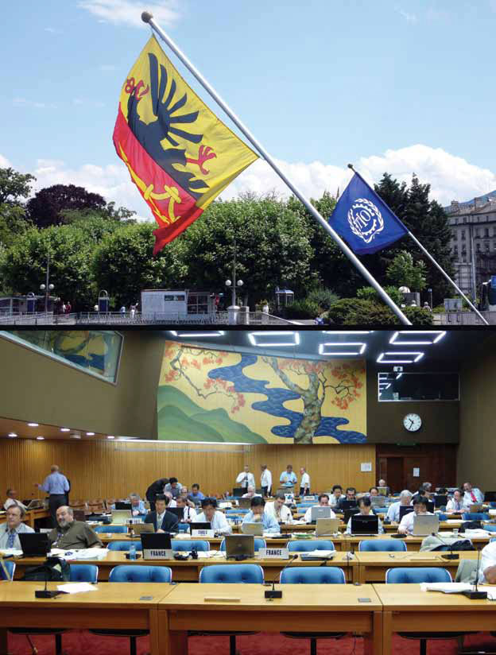
ITU-T and ITU-R Studies
Leadership of ITU and U.S. Telecommunications Standards Committees and Contributions
  U.S. Standards Proposals
  ITU Recommendations and Associated Industry Standards
  Technical Support for U.S. Administration in ITU-R Study Group 3 and Working Parties 3J, 3K, 3L, 3M, 5B, 5D, 6C, and ITU-T Study
  Group 9
  ITU-R U.S. Chair of Study Group 3
  ITU-T U.S. Chair of Study Group 9
  ITU-T International Chair of Study Group 9
Institute for Telecommunication Sciences – Boulder, Colorado

Slide 11
Questions?
Visit the ITS website and download publications at www.its.bldrdoc.gov
ITS Director’s Office
325 Broadway
Boulder, CO 80305
(303) 497-3500
Institute for Telecommunication Sciences – Boulder, Colorado
Notes:
Q & A

